Slide 1

Crime Analytics using NYPD Historical Complaint Data
INFO 6105 Final Project Presentation
Group 22
Team Members: Kshitij Prabhu (NEU ID:– 002769231)
Manav Hirey (NEU ID:- 002786706)

Slide 2
Introduction
Motivation
Goal
Dataset Description

Slide 3

Motivation
New York City's reputation as "the safest large city in America" has been shaken by the rise in crimes like homicides during the outbreak. With a larger perspective, things appear slightly differently.
The murder rate in 2009, when the city was struggling to recover from the last national economic catastrophe, is quite like the murder rate now.
Our goal is to enlighten newcomers and tourists about the city's safety issues so that they can stay safe.

Slide 4

Goal of the Project
We will focus on finding out what are the most unsafe boroughs and plot them on a map of New York City, classify crimes that have been committed using its description
Visualize the yearly crime rates and build a model that would accurately predict the future crime rates for the next two years.

Slide 5
Dataset Description
The dataset contains data points of all legitimate felonies, misdemeanors, and violations reports received by The New York City Police Department (NYPD) from 2006 to the end of 2021.
Link to our Dataset: NYPD Dataset

Slide 6

Results and Analysis on Data

Slide 7
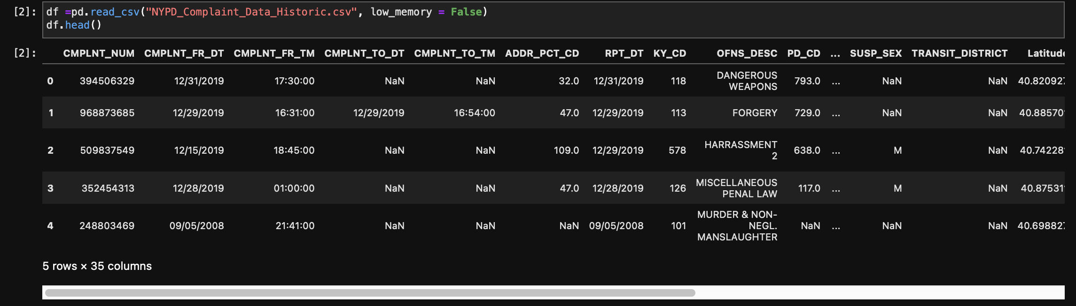
Data Preprocessing
We first extracted the dataset and printed the first 5 values of the dataset.

Slide 8
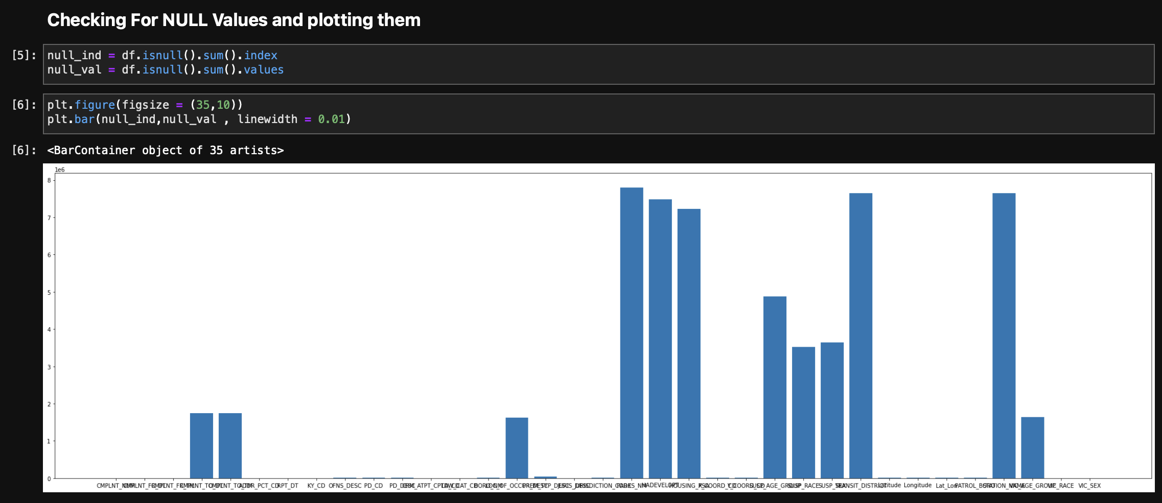
Data Preprocessing
We checked for Null Values next

Slide 9
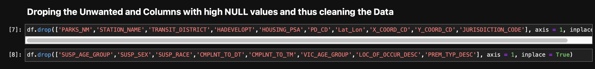
Data Preprocessing
Since we had Null values we dropped the Columns which were not required

Slide 10
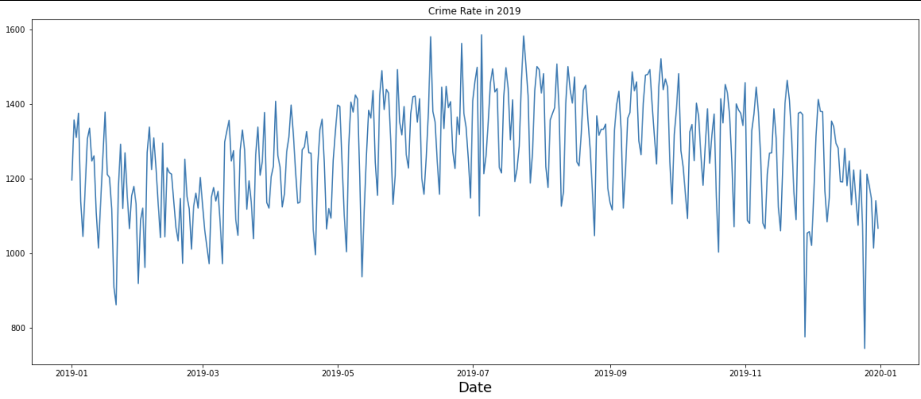
Algorithm 1&2
We first used Support Vector Machine and Linear Regression to predict the crime rate of 2019 for specific days in a row
In our case, we predicted the data for 25 days

Slide 11
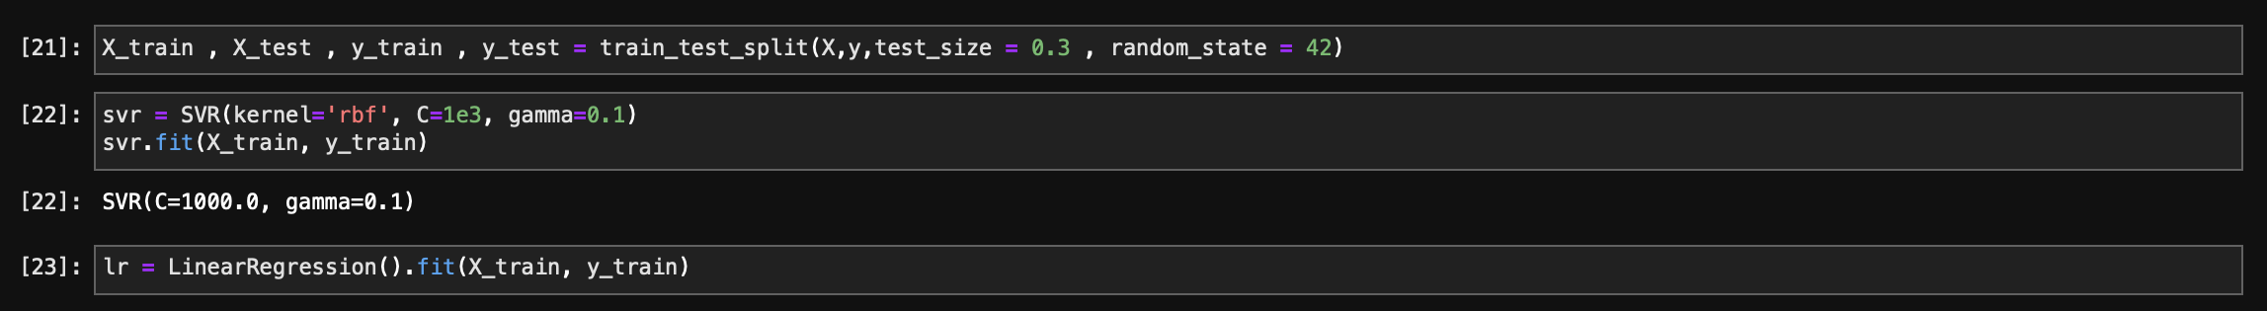
Algorithm 1&2
We split the dataset into 70%-30% and then used the train and test values to fit into the model
We used the sklearn module to retrieve SVR and LinearRegression as shown below

Slide 12
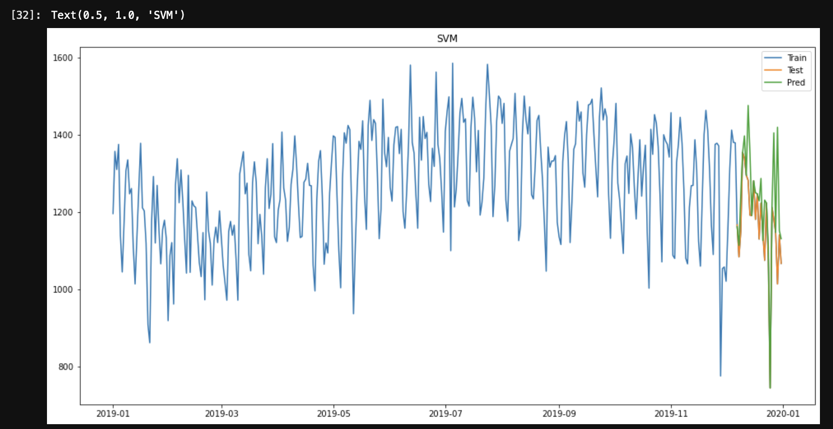
Algorithm 1&2 - Results

Slide 13
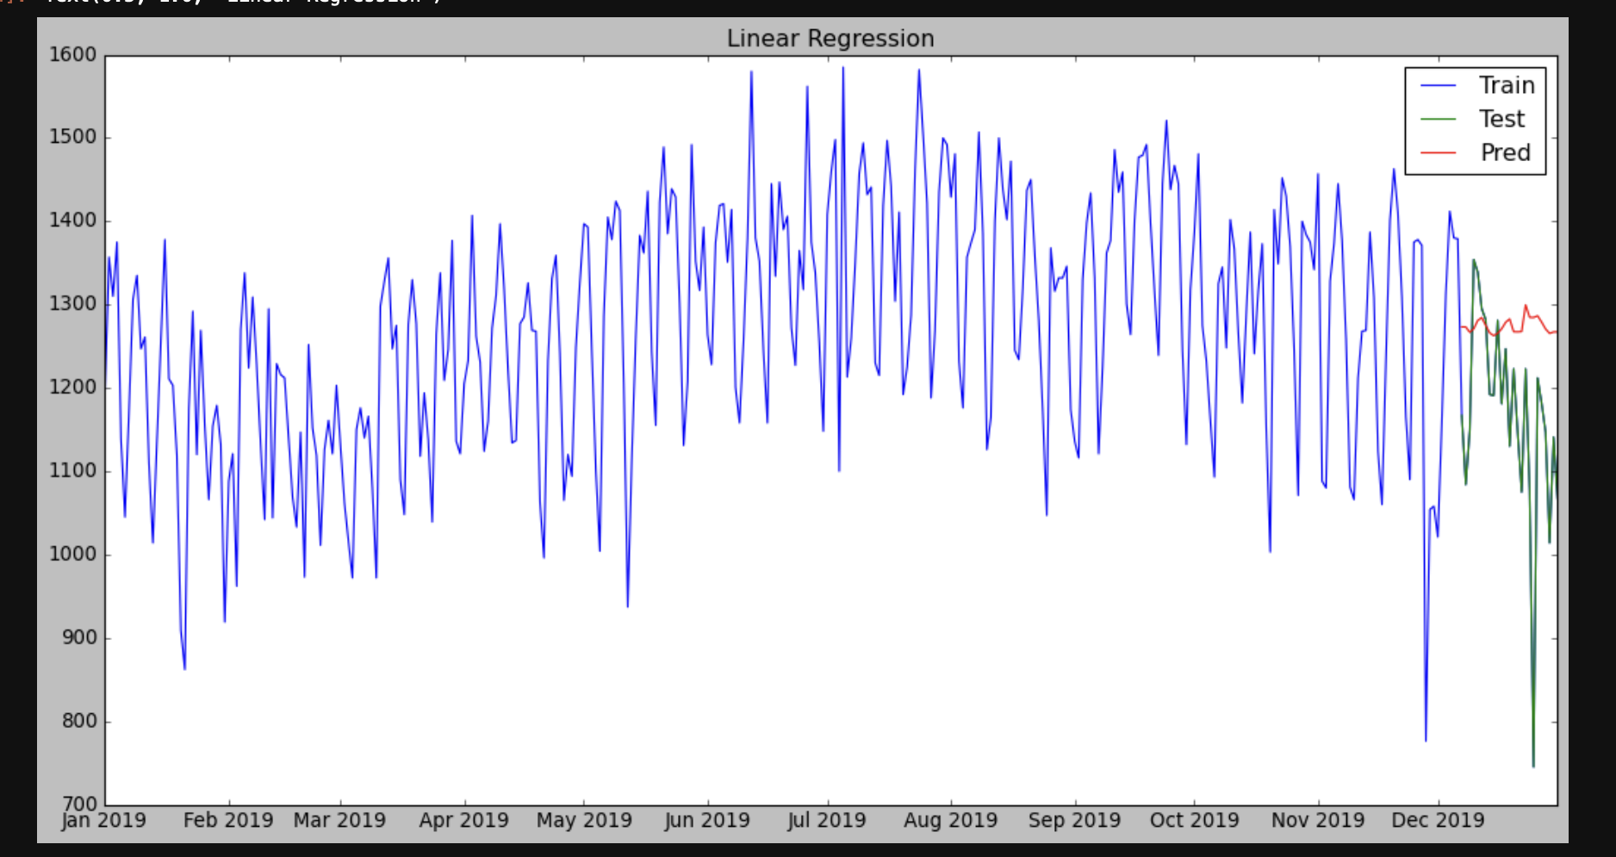
Algorithm 1&2 - Results

Slide 14
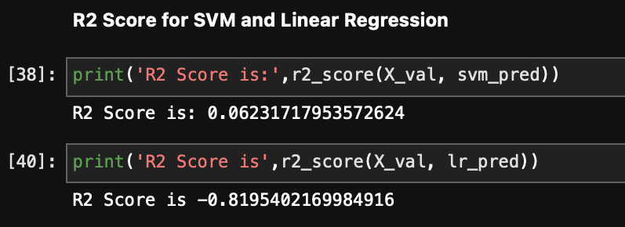
Algorithm 1&2 - Results
These are the R2 scores we got for our first Model

Slide 15
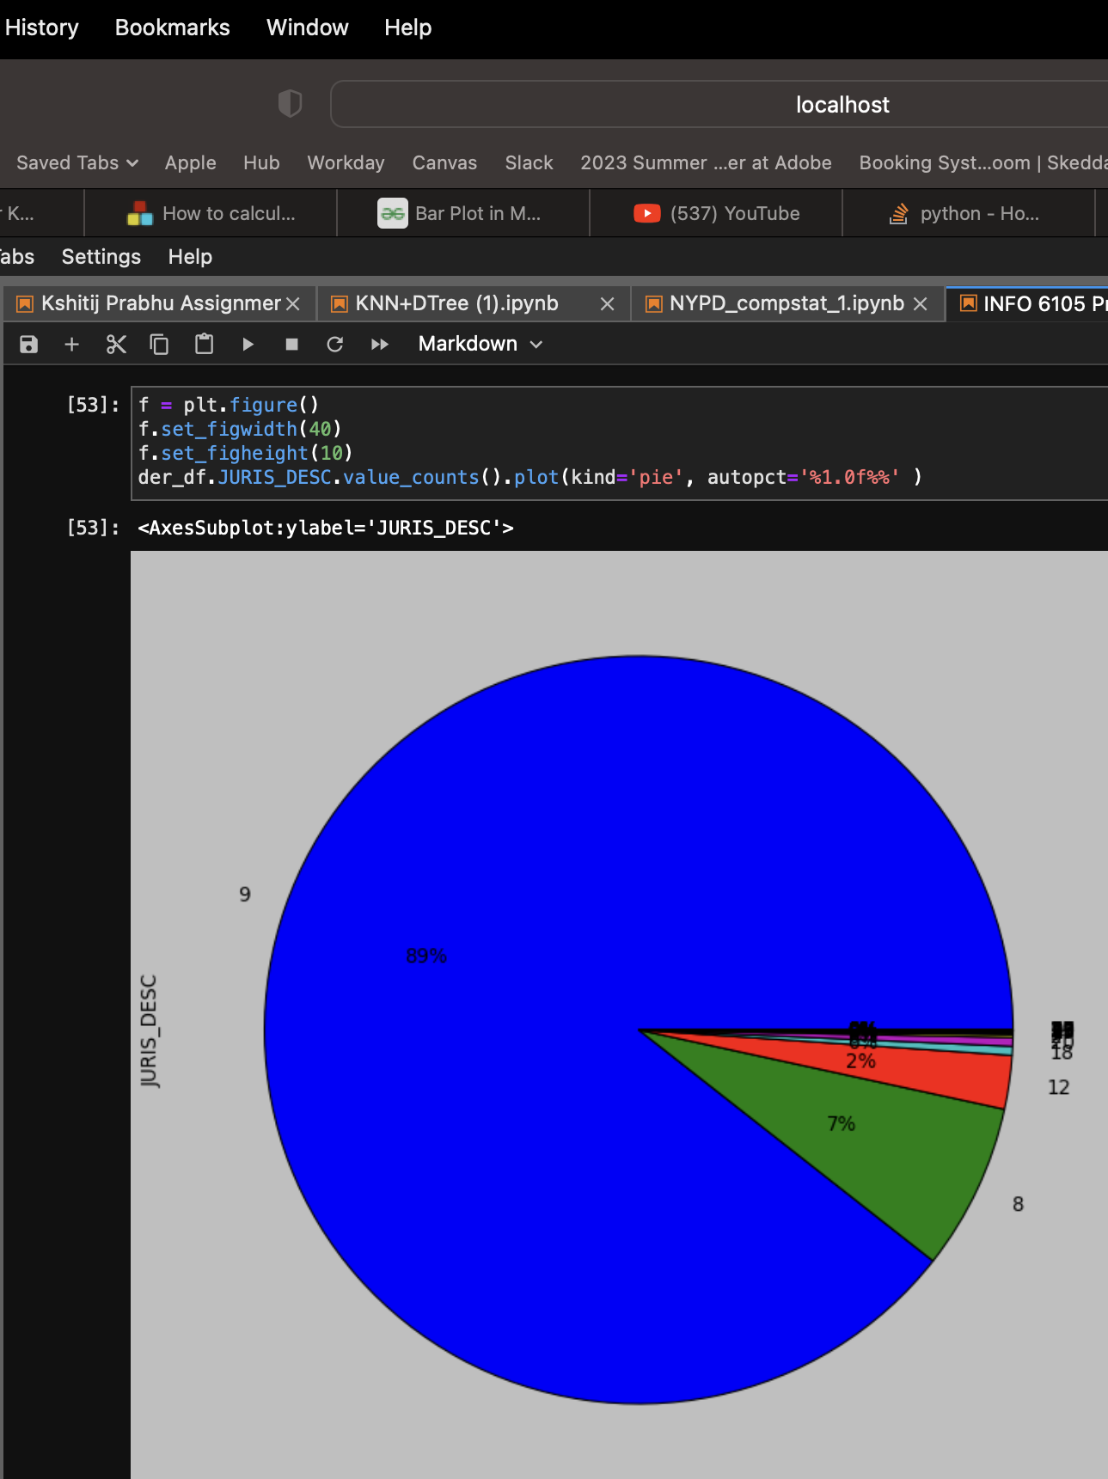
Algorithm 3&4
We used K-Nearest Neighbour and Decision Tree Regressor to classify which type of crime complaint was under what Jurisdiction

Slide 16
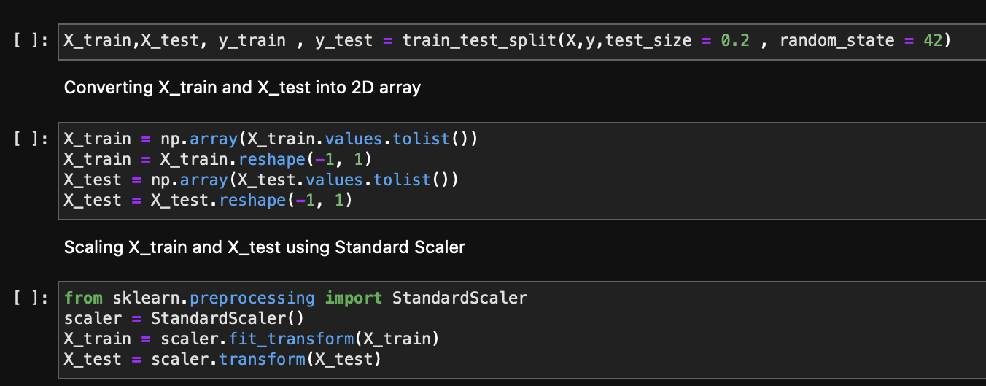
Algorithm 3&4
We split the dataset into 70%-30% and then used the train and test values to fit into the model
We used Standard scaling to scale the values down to get accurate results

Slide 17
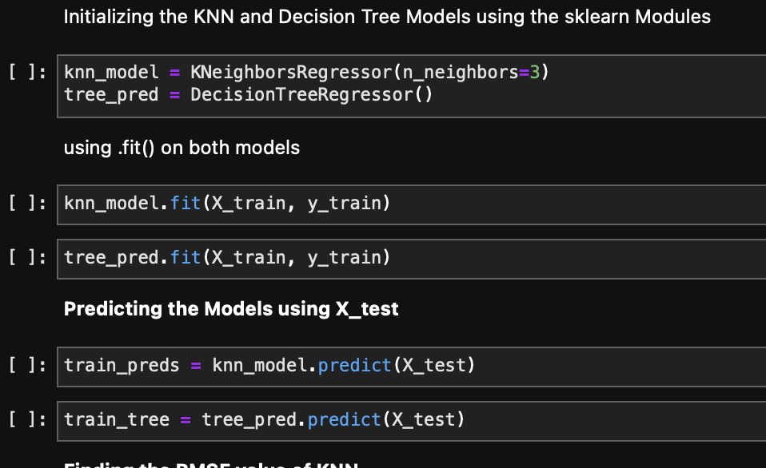
Algorithm 3&4
Using the sklearn module we extracted KNeighbourRegressor and DecisionTreeRegressor
We then fitted the split data into the models and predicted it

Slide 18
Algorithm 3&4
Using the sklearn module we extracted KNeighbourRegressor and DecisionTreeRegressor
We then fitted the split data into the models and predicted it

Slide 19
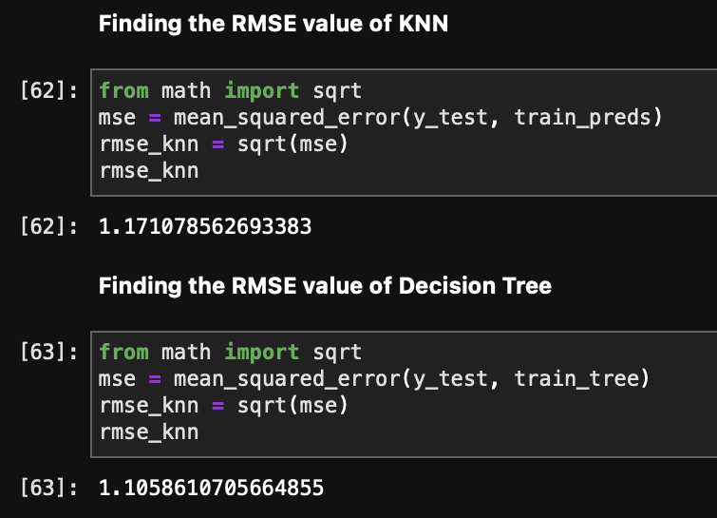
Algorithm 3&4 - Results
These are the RMSE values we got for the algorithms

Slide 20
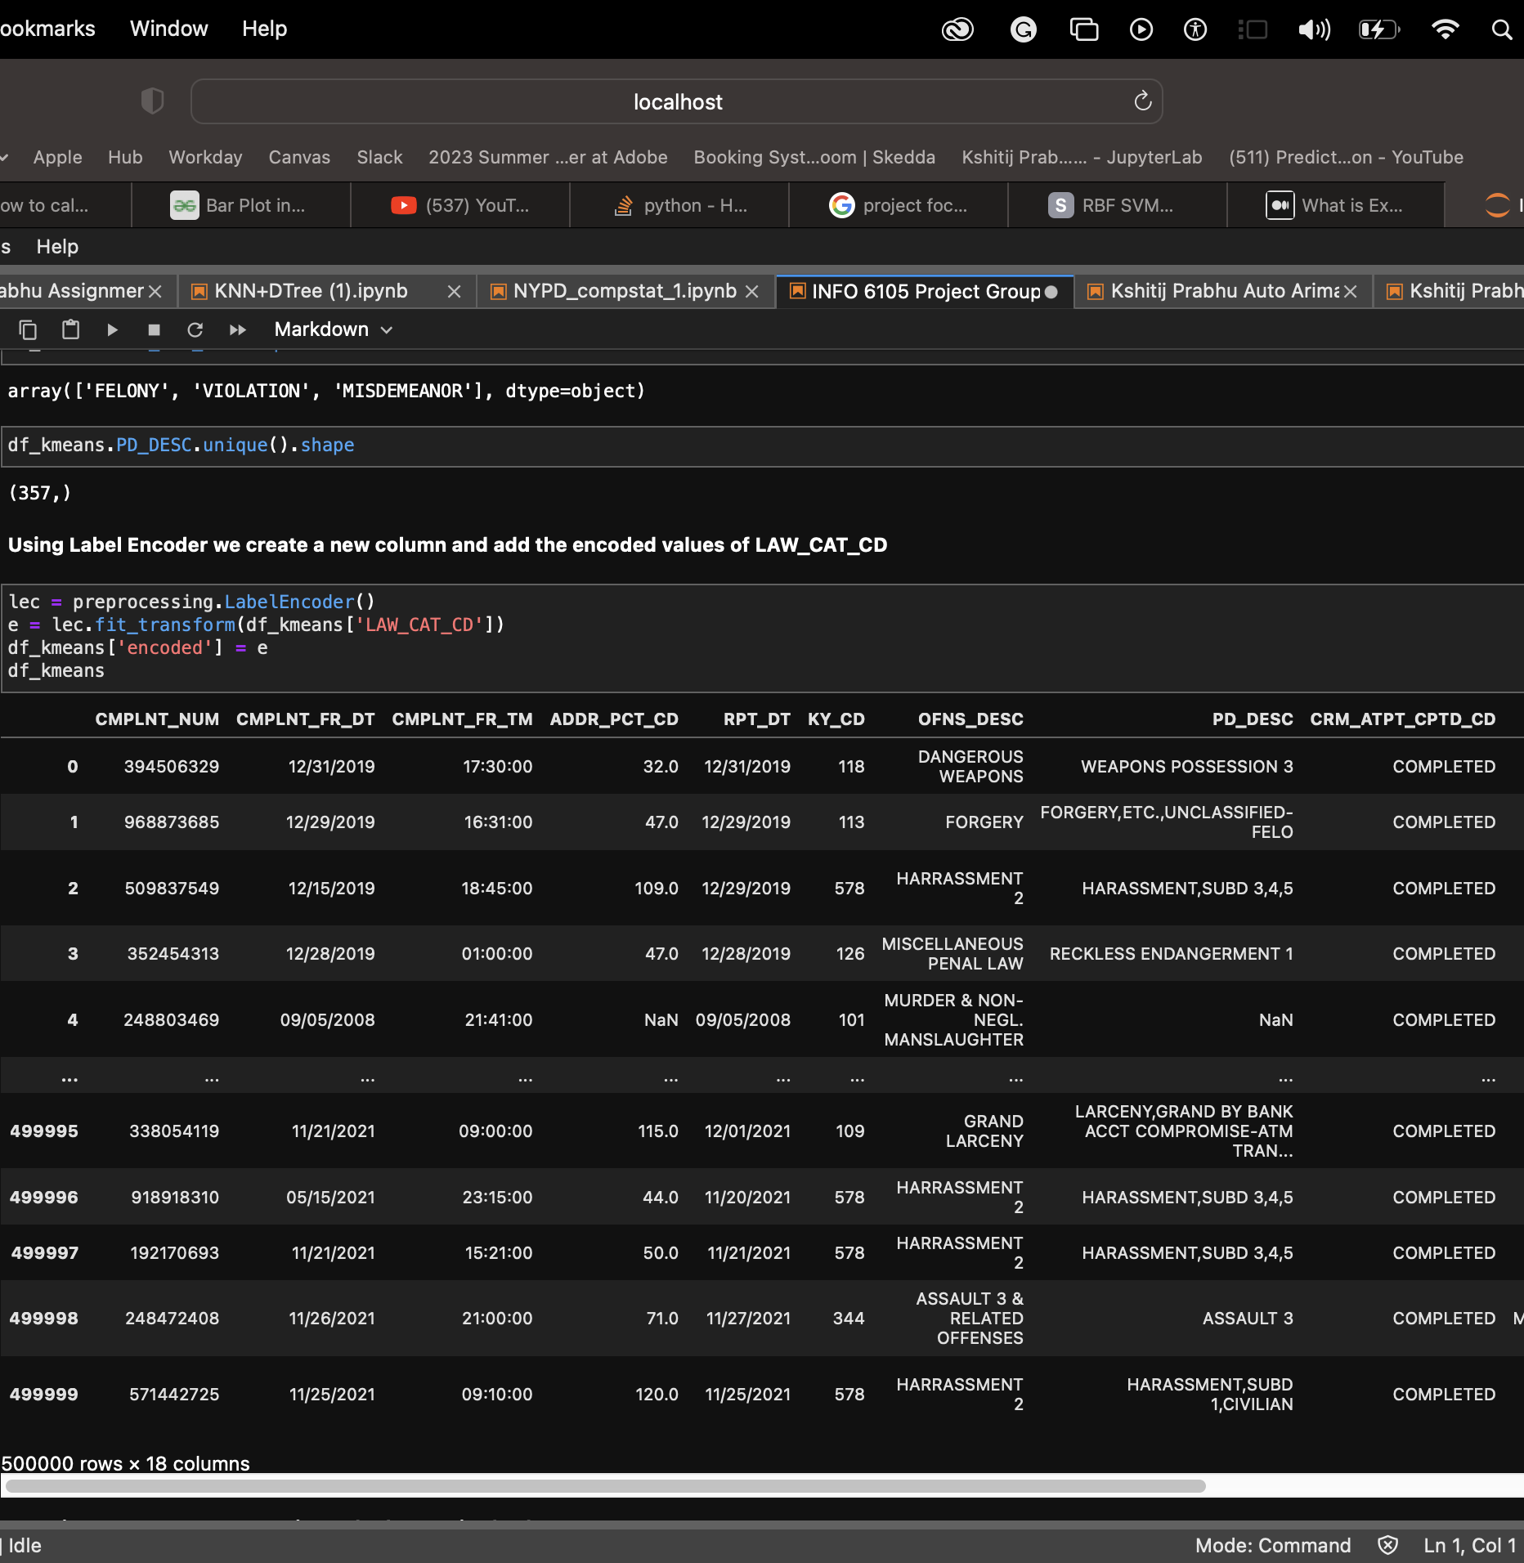
Algorithm 5&6
Here, we have used K-Means Clustering Algorithms and two types of Naive Bayes to classify Crime using the Crime Description
We used Label Encoder on the Crime type column so that we have a numerical value

Slide 21
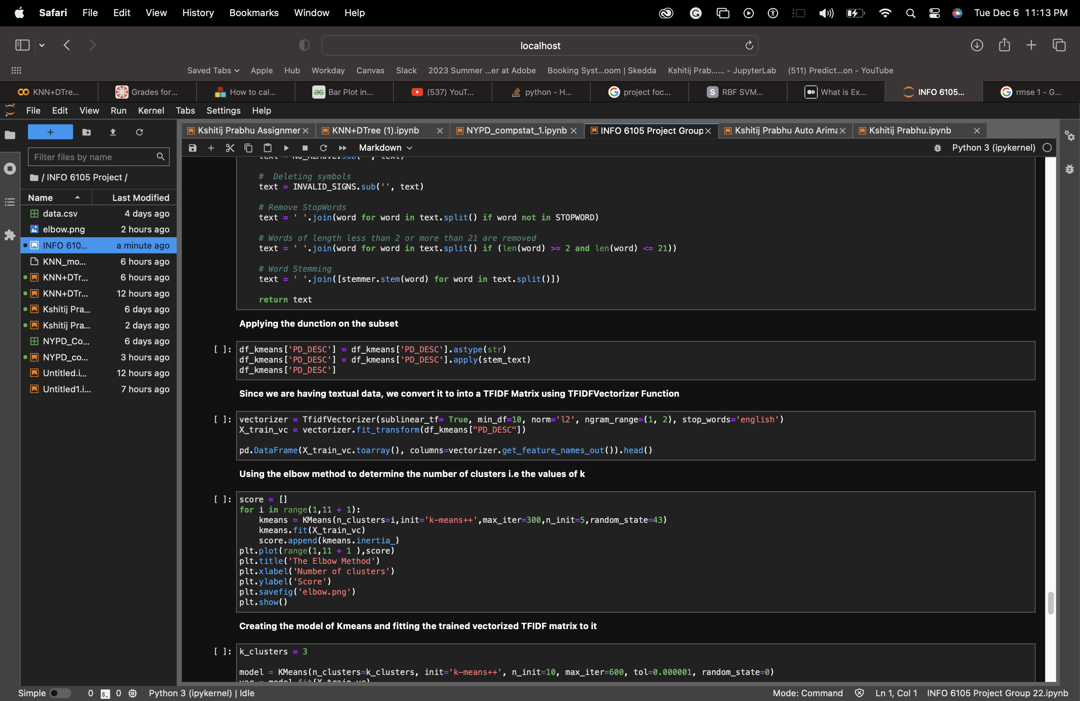
Algorithm 5&6
We used stemming, stopwords on the textual data and then used TFIDF Vectorizer to convert it into a sparse Matrix

Slide 22
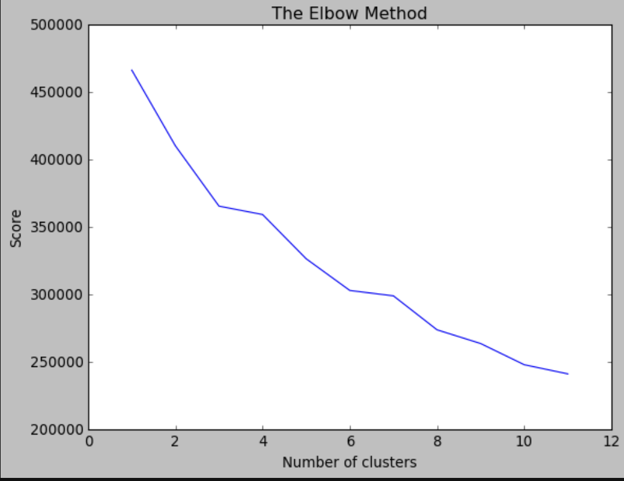
Algorithm 5&6
Using Elbow Method to determine the number of Clusters for K-Means Clustering

Slide 23
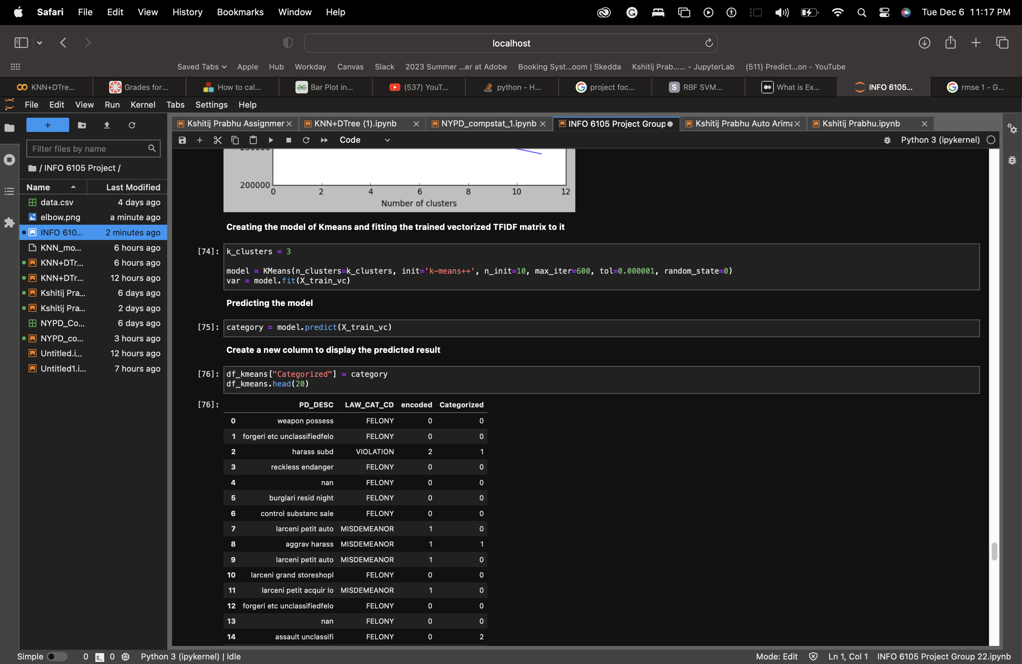
Algorithm 5&6
Kmeans sklearn function was used to fit the data and then predict using the k value

Slide 24
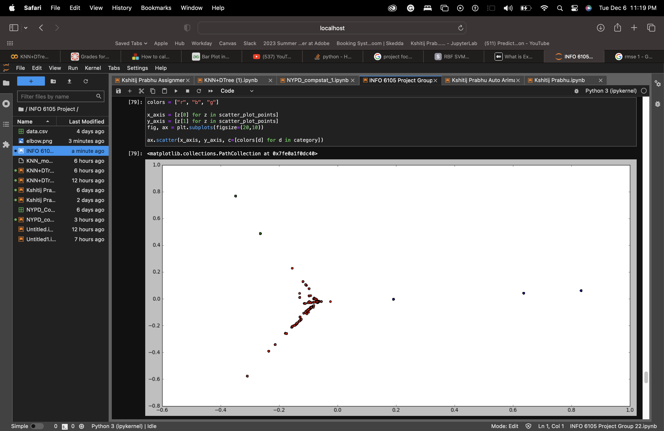
Algorithm 5&6 (K-Means Output)

Slide 25
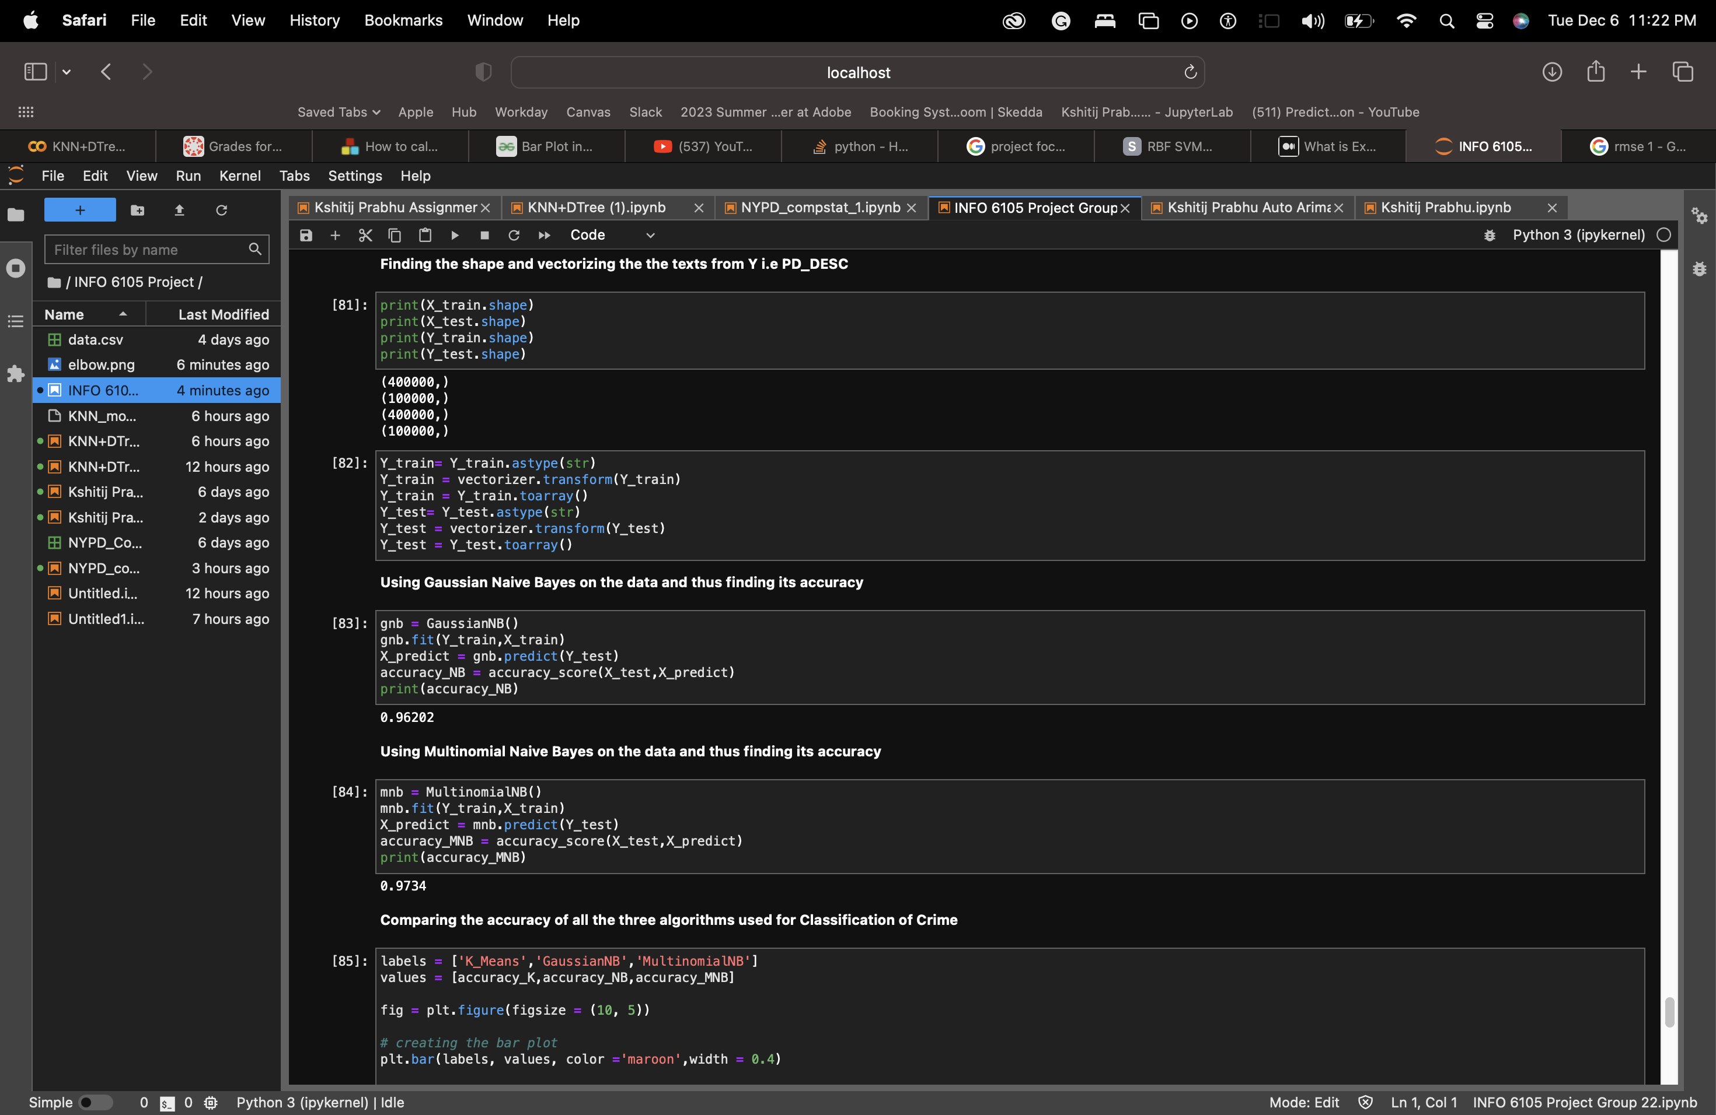
Algorithm 5&6 (Naïve Bayes Output)
Splitting the Data into 80%-20%
Extraction of Gaussian Naïve Bayes and Multinomial Naïve Bayes and thus predicting the accuracy value of each algorithm

Slide 26
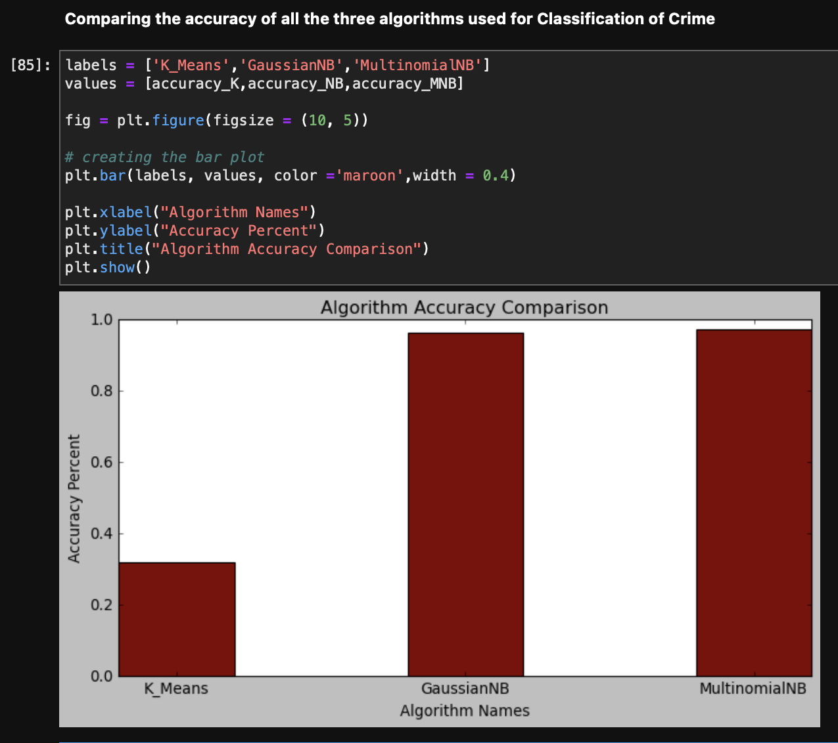
Algorithm 5&6 (Final Result)

Slide 27
Reference
https://towardsdatascience.com/machine-learning-basics-with-the-k-nearest-neighbors-algorithm-6a6e71d01761
https://learn.g2.com/k-nearest-neighbor
https://www.codingninjas.com/codestudio/library/knn-vs-k-means
https://www.google.com/search?client=safari&rls=en&q=gaussian+naive+bayes&ie=UTF-8&oe=UTF-8
https://scikit-learn.org/stable/modules/generated/sklearn.naive_bayes.MultinomialNB.html
https://jakevdp.github.io/PythonDataScienceHandbook/05.05-naive-bayes.html
https://www.geeksforgeeks.org/decision-tree-implementation-python/
https://machinelearningmastery.com/implement-decision-tree-algorithm-scratch-python/

Slide 28

Thank You

